Slide 1
Natural Language Processing Specialization N-Grams Language Model and Autocomplete
(2021 Deeplearning.ai)
YangXi’s Reading Notes

Slide 2
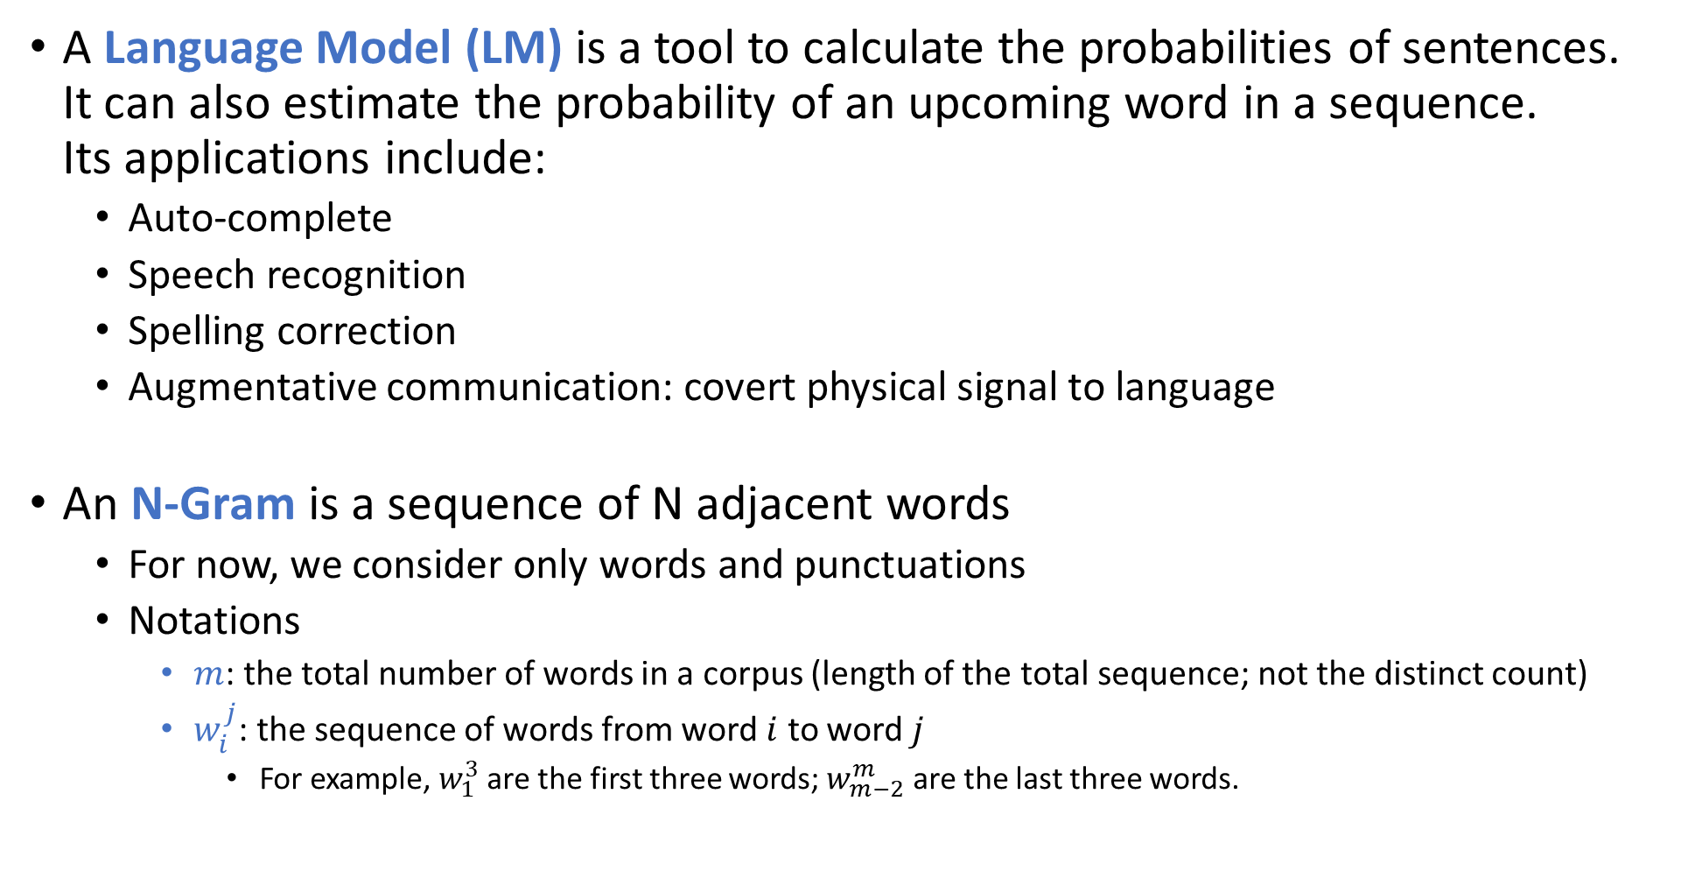
N-Gram Language Model
A Language Model (LM) is a tool to calculate the probabilities of sentences. It can also estimate the probability of an upcoming word in a sequence. Its applications include:
Auto-complete
Speech recognition
Spelling correction
Augmentative communication: covert physical signal to language
An N-Gram is a sequence of N adjacent words
For now, we consider only words and punctuations
Notations
$m$: the total number of words in a corpus (length of the total sequence; not the distinct count)
$w_{i}^{j}$: the sequence of words from word $i$ to word $j$
For example, $w_{1}^{3}$ are the first three words; $w_{m−2}^{m}$ are the last three words.

Slide 3
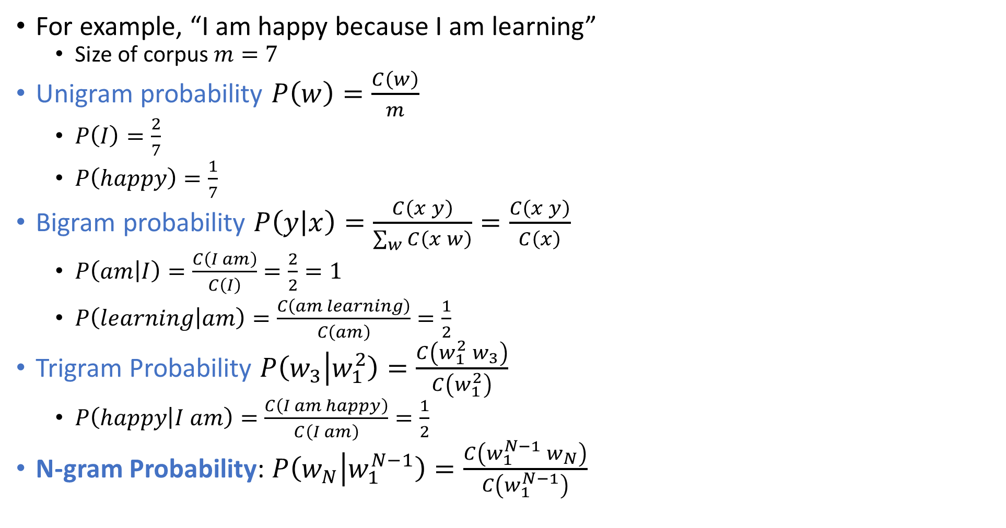
N-Gram Probability
For example, “I am happy because I am learning”
Size of corpus $m=7$
Unigram probability $P\left(w\right)=\frac{C\left(w\right)}{m}$
$P\left(I\right)=\frac{2}{7}$
$P\left(happy\right)=\frac{1}{7}$
Bigram probability $P\left(y | x\right)=\frac{C\left(x y\right)}{\sum_{w}{C\left(x w\right)}}=\frac{C\left(x y\right)}{C\left(x\right)}$
$P\left(am | I\right)=\frac{C\left(I am\right)}{C\left(I\right)}=\frac{2}{2}=1$
$P\left(learning | am\right)=\frac{C\left(am learning\right)}{C\left(am\right)}=\frac{1}{2}$
Trigram Probability $P\left(w_{3} | w_{1}^{2}\right)=\frac{C\left(w_{1}^{2} w_{3}\right)}{C\left(w_{1}^{2}\right)}$
$P\left(happy | I am\right)=\frac{C\left(I am happy\right)}{C\left(I am\right)}=\frac{1}{2}$
N-gram Probability: $P\left(w_{N} | w_{1}^{N−1}\right)=\frac{C\left(w_{1}^{N−1} w_{N}\right)}{C\left(w_{1}^{N−1}\right)}$

Slide 4
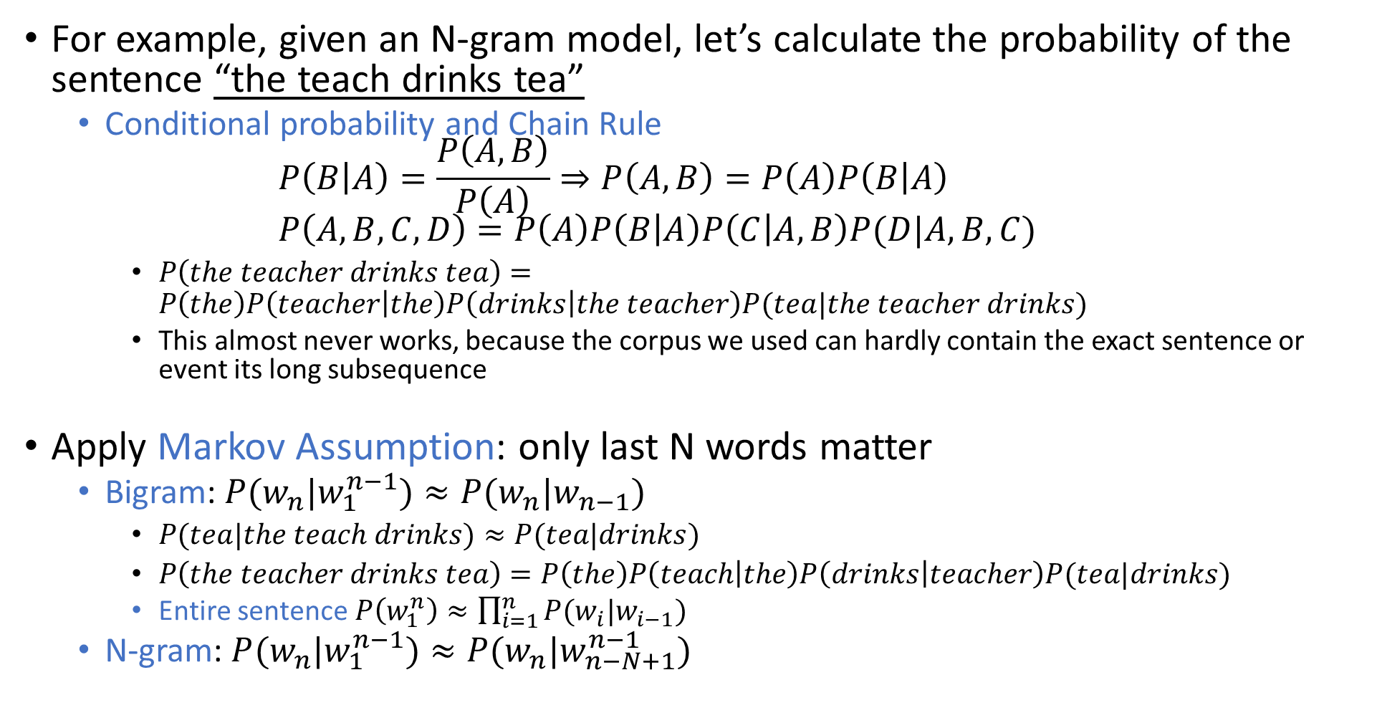
Probability of a Sequence
For example, given an N-gram model, let’s calculate the probability of the sentence “the teach drinks tea”
Conditional probability and Chain Rule $P\left(B | A\right)=\frac{P\left(A,B\right)}{P\left(A\right)}⇒P\left(A,B\right)=P\left(A\right)P\left(B | A\right)$ $P\left(A,B,C,D\right)=P\left(A\right)P\left(B | A\right)P\left(C | A,B\right)P(D|A,B,C)$
$P\left(the teacher drinks tea\right)=P\left(the\right)P\left(teacher | the\right)P\left(drinks | the teacher\right)P(tea|the teacher drinks)$
This almost never works, because the corpus we used can hardly contain the exact sentence or event its long subsequence
Apply Markov Assumption: only last N words matter
Bigram: $P(w_{n}|w_{1}^{n−1})≈P(w_{n}|w_{n−1})$
$P(tea|the teach drinks)≈P(tea|drinks)$
$P\left(the teacher drinks tea\right)=P\left(the\right)P\left(teach | the\right)P\left(drinks | teacher\right)P(tea|drinks)$
Entire sentence$P\left(w_{1}^{n}\right)≈\prod_{i=1}^{n}{P(w_{i}|w_{i−1})}$
N-gram: $P(w_{n}|w_{1}^{n−1})≈P(w_{n}|w_{n−N+1}^{n−1})$

Slide 5
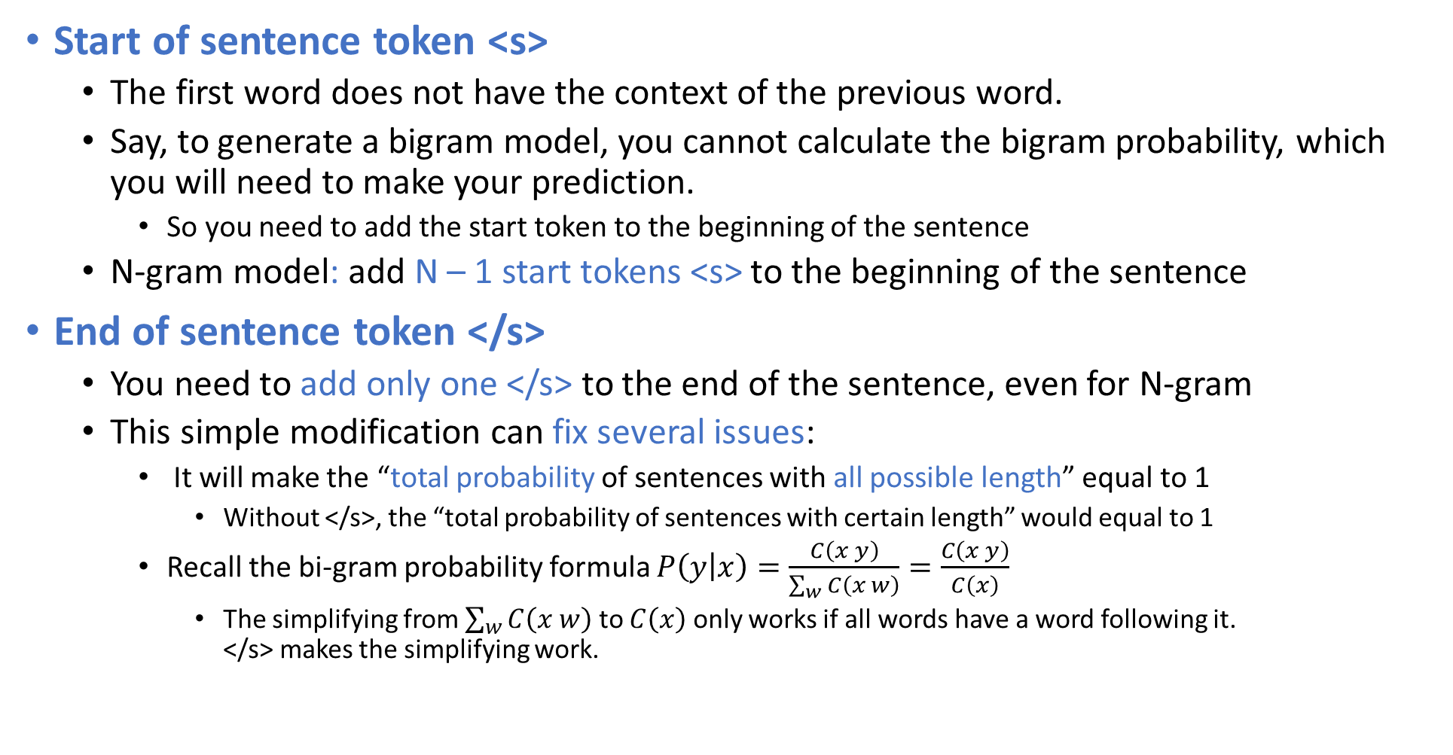
Starting and Ending of Sentences
Start of sentence token <s>
The first word does not have the context of the previous word.
Say, to generate a bigram model, you cannot calculate the bigram probability, which you will need to make your prediction.
So you need to add the start token to the beginning of the sentence
N-gram model: add N – 1 start tokens <s> to the beginning of the sentence
End of sentence token </s>
You need to add only one </s> to the end of the sentence, even for N-gram
This simple modification can fix several issues:
It will make the “total probability of sentences with all possible length” equal to 1
Without </s>, the “total probability of sentences with certain length” would equal to 1
Recall the bi-gram probability formula $P\left(y | x\right)=\frac{C\left(x y\right)}{\sum_{w}{C\left(x w\right)}}=\frac{C\left(x y\right)}{C\left(x\right)}$
The simplifying from $\sum_{w}{C\left(x w\right)}$ to $C\left(x\right)$ only works if all words have a word following it. </s> makes the simplifying work.

Slide 6
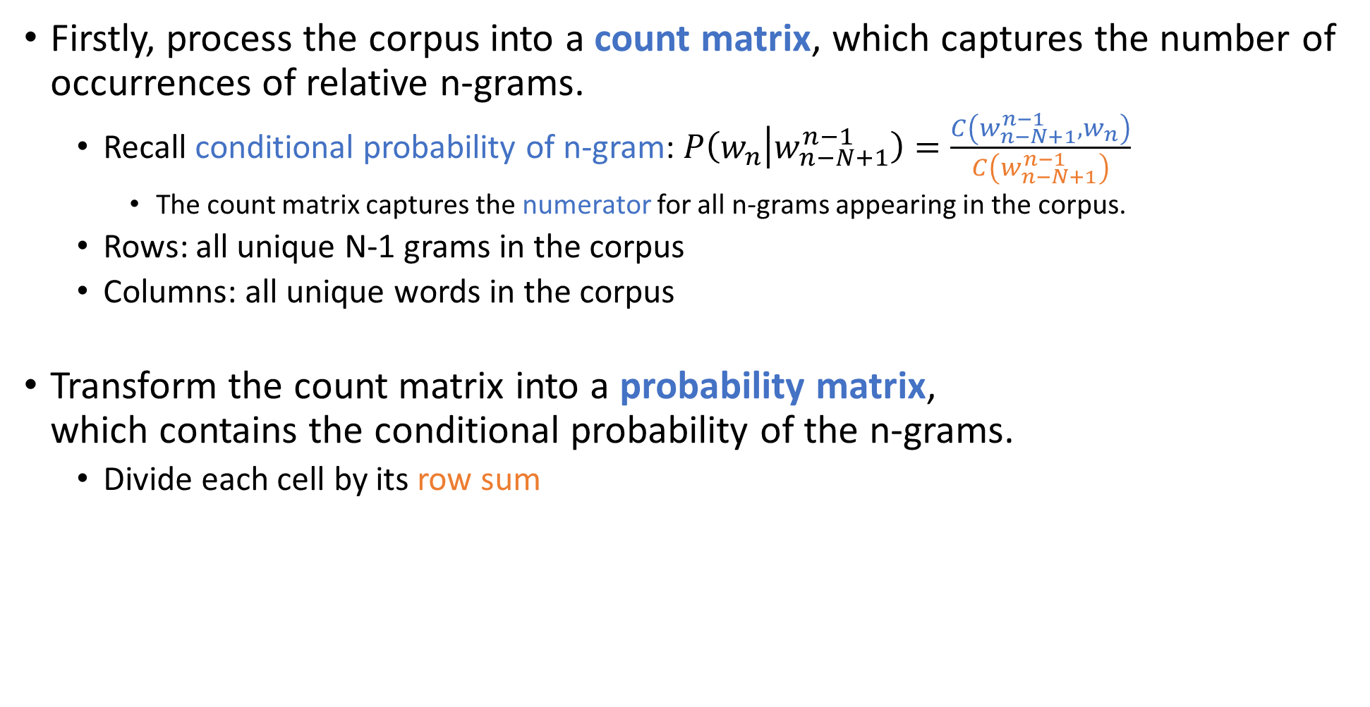
Build an N-gram Language Model
Firstly, process the corpus into a count matrix, which captures the number of occurrences of relative n-grams.
Recall conditional probability of n-gram: $P\left(w_{n} | w_{n−N+1}^{n−1}\right)=\frac{C\left(w_{n−N+1}^{n−1},w_{n}\right)}{C\left(w_{n−N+1}^{n−1}\right)}$
The count matrix captures the numerator for all n-grams appearing in the corpus.
Rows: all unique N-1 grams in the corpus
Columns: all unique words in the corpus
Transform the count matrix into a probability matrix, which contains the conditional probability of the n-grams.
Divide each cell by its row sum
Example: count matrix of corpus “<s> I study I learn </s>”
 | <s> | </s> | I | study | learn
<s> | 0 | 0 | 1 | 0 | 0
</s> | 0 | 0 | 0 | 0 | 0
I | 0 | 0 | 0 | 1 | 1
study | 0 | 0 | 1 | 0 | 0
learn | 0 | 1 | 0 | 0 | 0
Probability matrix
 | <s> | </s> | I | study | learn
<s> | 0 | 0 | 1 | 0 | 0
</s> | 0 | 0 | 0 | 0 | 0
I | 0 | 0 | 0 | 0.5 | 0.5
study | 0 | 0 | 1 | 0 | 0
learn | 0 | 1 | 0 | 0 | 0

Slide 7
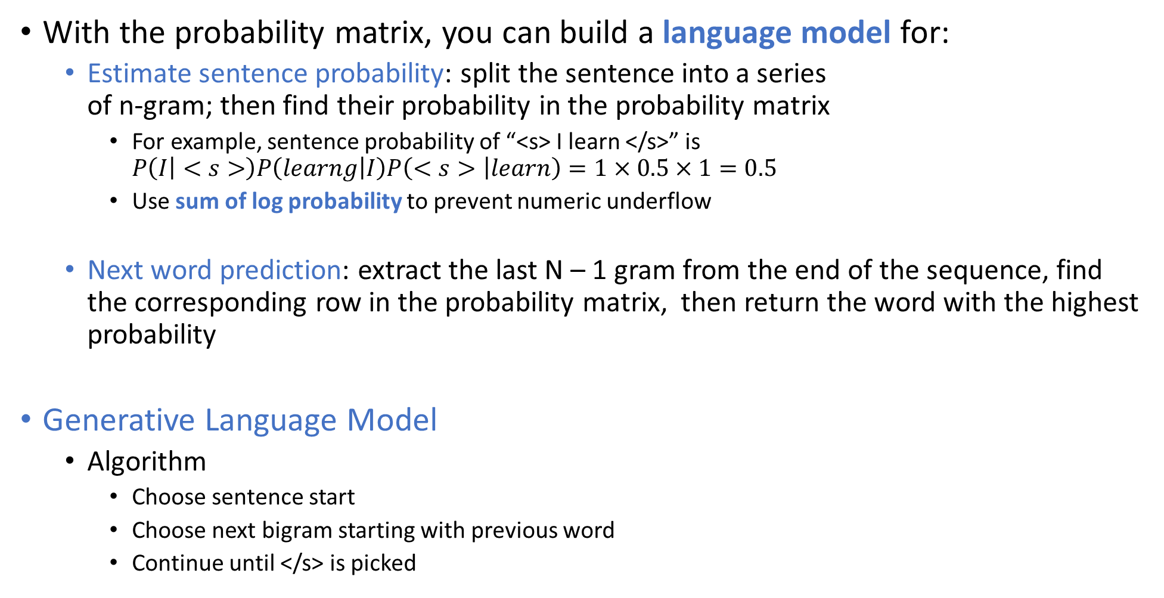
Build an N-gram Language Model
With the probability matrix, you can build a language model for:
Estimate sentence probability: split the sentence into a series of n-gram; then find their probability in the probability matrix
For example, sentence probability of “<s> I learn </s>” is $P\left(I | <s>\right)P\left(learng | I\right)P\left(<s> | learn\right)=1×0.5×1=0.5$
Use sum of log probability to prevent numeric underflow
Next word prediction: extract the last N – 1 gram from the end of the sequence, find the corresponding row in the probability matrix, then return the word with the highest probability
Generative Language Model
Algorithm
Choose sentence start
Choose next bigram starting with previous word
Continue until </s> is picked
 | <s> | </s> | I | study | learn
<s> | 0 | 0 | 1 | 0 | 0
</s> | 0 | 0 | 0 | 0 | 0
I | 0 | 0 | 0 | 0.5 | 0.5
study | 0 | 0 | 1 | 0 | 0
learn | 0 | 1 | 0 | 0 | 0

Slide 8
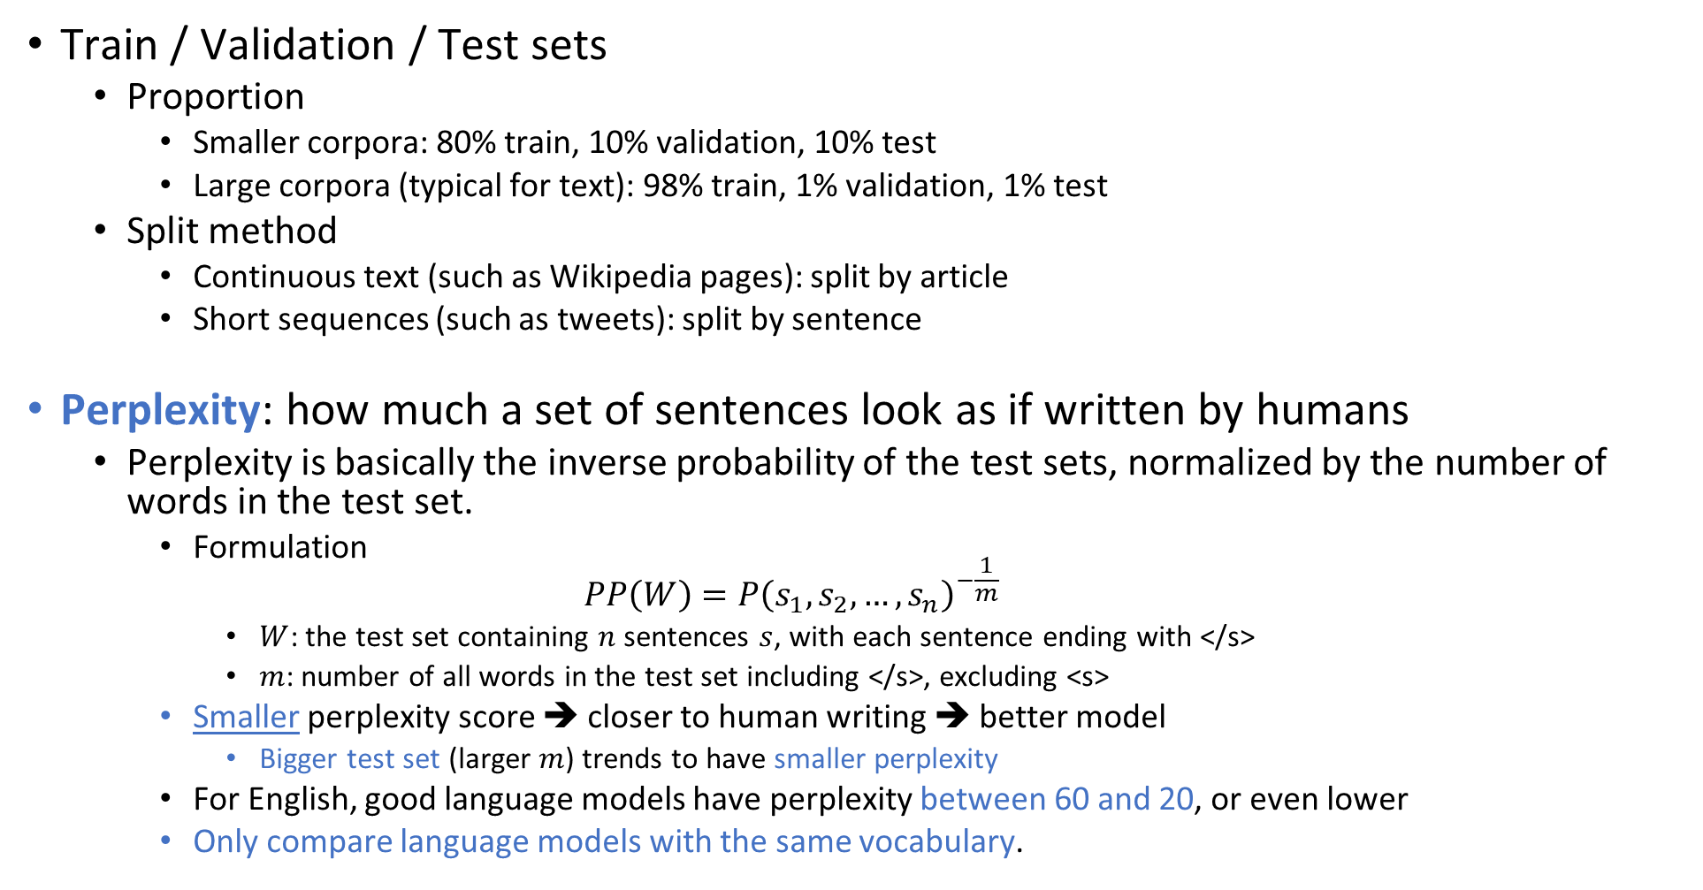
Language Model Evaluation
Train / Validation / Test sets
Proportion
Smaller corpora: 80% train, 10% validation, 10% test
Large corpora (typical for text): 98% train, 1% validation, 1% test
Split method
Continuous text (such as Wikipedia pages): split by article
Short sequences (such as tweets): split by sentence
Perplexity: how much a set of sentences look as if written by humans
Perplexity is basically the inverse probability of the test sets, normalized by the number of words in the test set.
Formulation $PP\left(W\right)=P{\left(s_{1},s_{2},…,s_{n}\right)}^{−\frac{1}{m}}$
$W$: the test set containing $n$ sentences $s$, with each sentence ending with </s>
$m$: number of all words in the test set including </s>, excluding <s>
Smaller perplexity score ➔ closer to human writing ➔ better model
Bigger test set (larger $m$) trends to have smaller perplexity
For English, good language models have perplexity between 60 and 20, or even lower
Only compare language models with the same vocabulary.

Slide 9

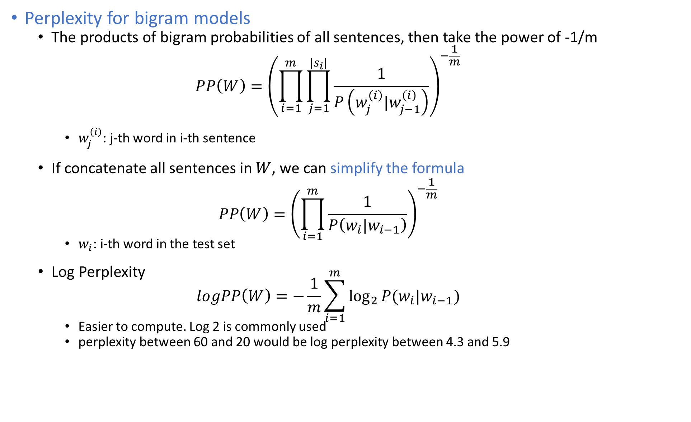
Language Model Evaluation
$$PP\left(W\right)=P{\left(s_{1},s_{2},…,s_{n}\right)}^{−\frac{1}{m}}$$
Perplexity for bigram models
The products of bigram probabilities of all sentences, then take the power of -1/m $PP\left(W\right)={\left(\prod_{i=1}^{m}{\prod_{j=1}^{|s_{i}|}{\frac{1}{P\left(w_{j}^{\left(i\right)}|w_{j−1}^{\left(i\right)}\right)}}}\right)}^{−\frac{1}{m}}$
$w_{j}^{(i)}$: j-th word in i-th sentence
If concatenate all sentences in $W$, we can simplify the formula $PP\left(W\right)={\left(\prod_{i=1}^{m}{\frac{1}{P\left(w_{i}|w_{i−1}\right)}}\right)}^{−\frac{1}{m}}$
$w_{i}$: i-th word in the test set
Log Perplexity $logPP\left(W\right)=−\frac{1}{m}\sum_{i=1}^{m}{\log_{2}{P(w_{i}|w_{i−1})}}$
Easier to compute. Log 2 is commonly used
perplexity between 60 and 20 would be log perplexity between 4.3 and 5.9

Slide 10
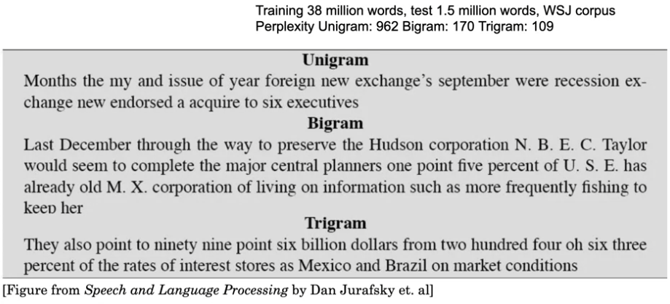
Language Model Evaluation

Slide 11
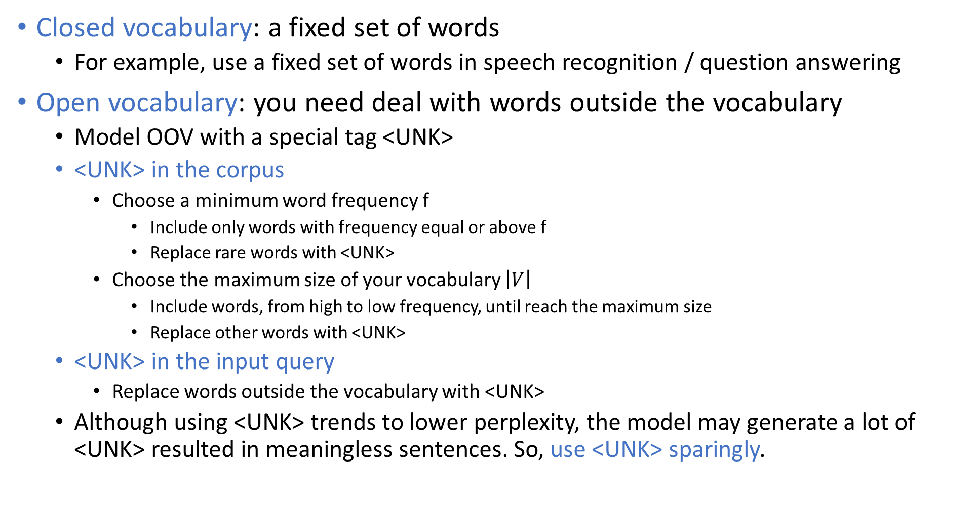
Out of Vocabulary Words (OOV)
Closed vocabulary: a fixed set of words
For example, use a fixed set of words in speech recognition / question answering
Open vocabulary: you need deal with words outside the vocabulary
Model OOV with a special tag <UNK>
<UNK> in the corpus
Choose a minimum word frequency f
Include only words with frequency equal or above f
Replace rare words with <UNK>
Choose the maximum size of your vocabulary $\left|V\right|$
Include words, from high to low frequency, until reach the maximum size
Replace other words with <UNK>
<UNK> in the input query
Replace words outside the vocabulary with <UNK>
Although using <UNK> trends to lower perplexity, the model may generate a lot of <UNK> resulted in meaningless sentences. So, use <UNK> sparingly.

Slide 12
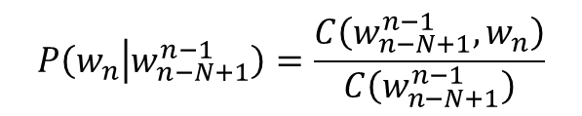
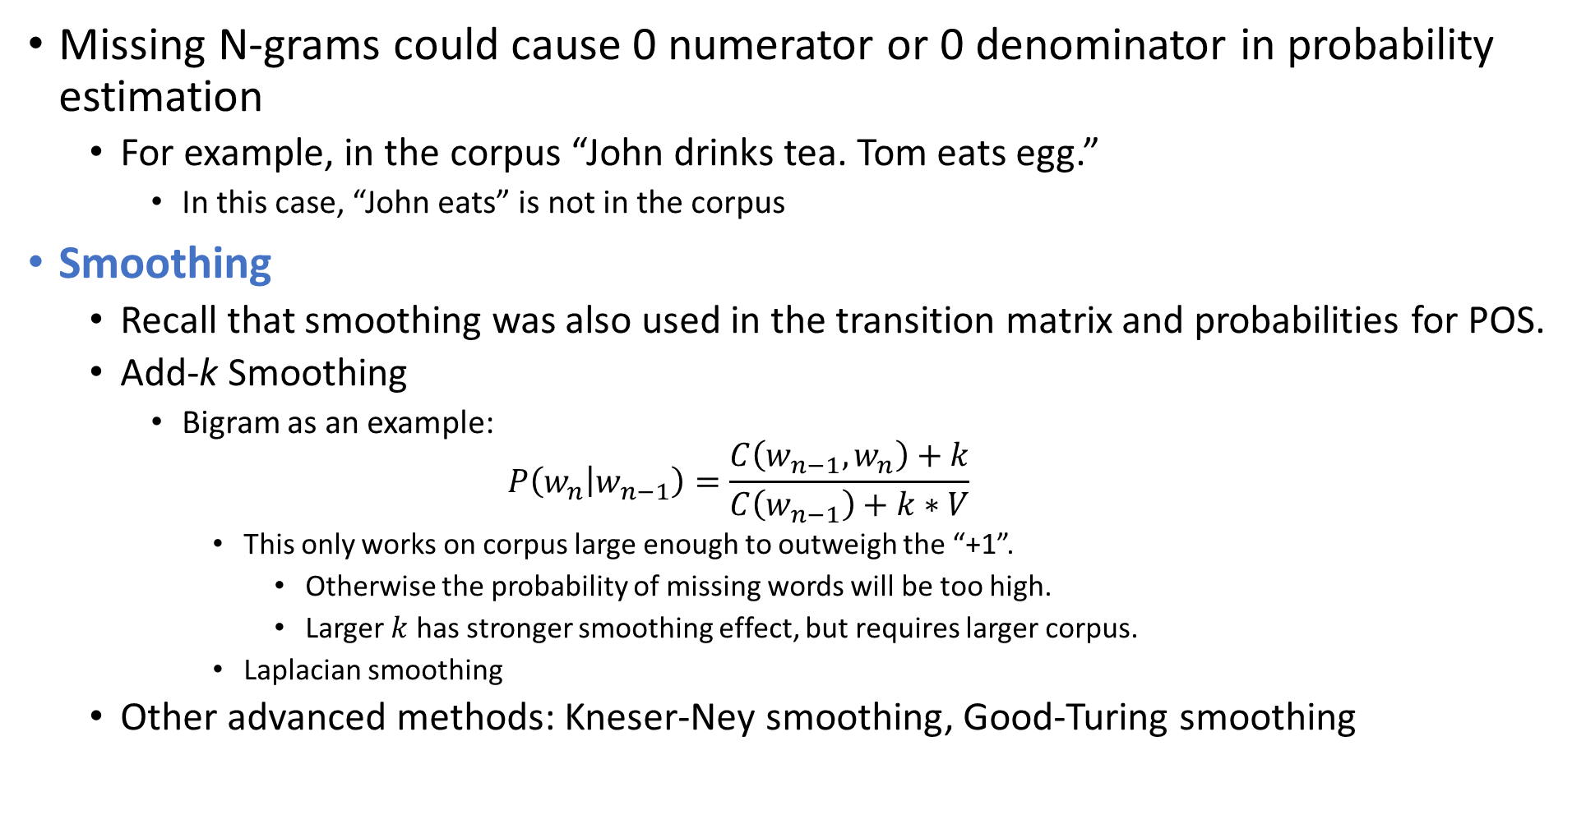
Missing N-grams in Training Corpus
Missing N-grams could cause 0 numerator or 0 denominator in probability estimation
For example, in the corpus “John drinks tea. Tom eats egg.”
In this case, “John eats” is not in the corpus
Smoothing
Recall that smoothing was also used in the transition matrix and probabilities for POS.
Add-k Smoothing
Bigram as an example: $P\left(w_{n} | w_{n−1}\right)=\frac{C\left(w_{n−1},w_{n}\right)+k}{C\left(w_{n−1}\right)+k∗V}$
This only works on corpus large enough to outweigh the “+1”.
Otherwise the probability of missing words will be too high.
Larger $k$ has stronger smoothing effect, but requires larger corpus.
Laplacian smoothing
Other advanced methods: Kneser-Ney smoothing, Good-Turing smoothing
$$P\left(w_{n} | w_{n−N+1}^{n−1}\right)=\frac{C\left(w_{n−N+1}^{n−1},w_{n}\right)}{C\left(w_{n−N+1}^{n−1}\right)}$$

Slide 13
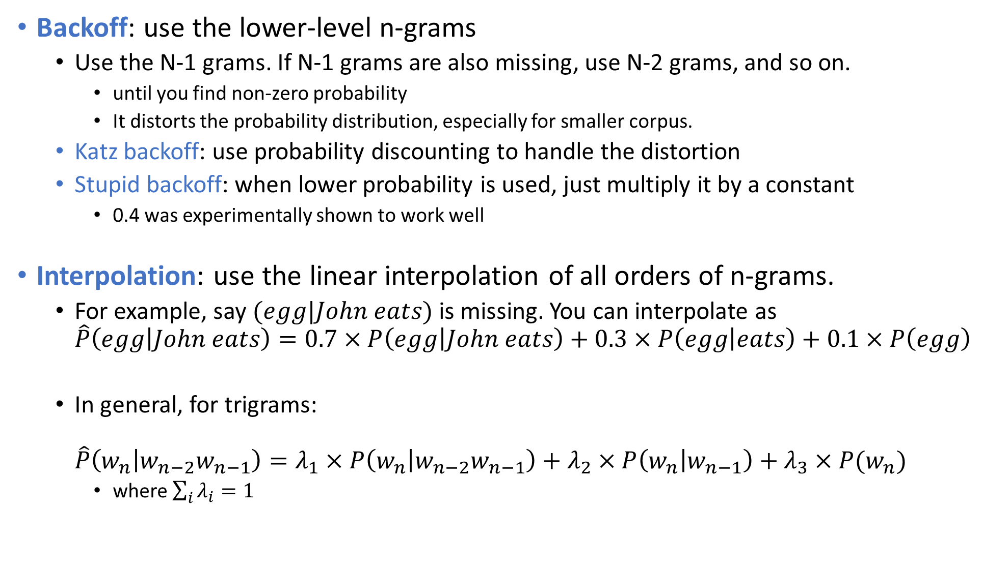
Missing N-grams in Training Corpus
Backoff: use the lower-level n-grams
Use the N-1 grams. If N-1 grams are also missing, use N-2 grams, and so on.
until you find non-zero probability
It distorts the probability distribution, especially for smaller corpus.
Katz backoff: use probability discounting to handle the distortion
Stupid backoff: when lower probability is used, just multiply it by a constant
0.4 was experimentally shown to work well
Interpolation: use the linear interpolation of all orders of n-grams.
For example, say $(egg|John eats)$ is missing. You can interpolate as $\hat{P}\left(egg | John eats\right)=0.7×P\left(egg | John eats\right)+0.3×P\left(egg | eats\right)+0.1×P\left(egg\right)$
In general, for trigrams: $\hat{P}\left(w_{n} | w_{n−2}w_{n−1}\right)=λ_{1}×P\left(w_{n} | w_{n−2}w_{n−1}\right)+λ_{2}×P\left(w_{n} | w_{n−1}\right)+λ_{3}×P(w_{n})$
where $\sum_{i}{λ_{i}}=1$

